Slide 1
MazY
Steve Mahar
Peter Tuerk

Slide 2
What Is MazY?
Line Following Robot
Controlled By An Android App
Our Goals
Explore Mazes
Optimize Routes

Slide 3
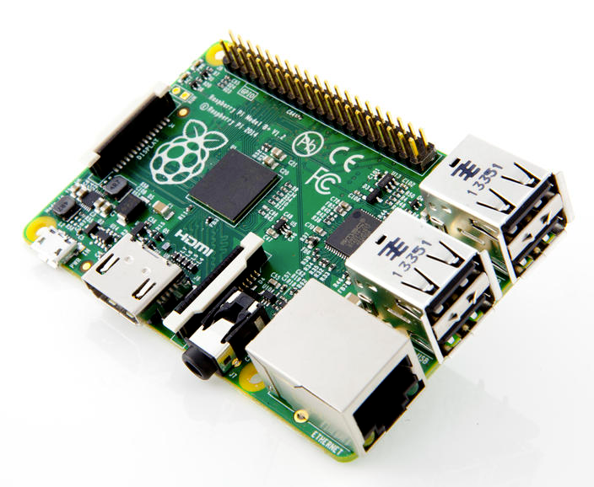
MazY’s Hardware
Raspberry Pi B+
Bluetooth Dongle
2 Leggo Motors
L298N Motor Controller
2 Custom Optical Line Sensors

Slide 4

MazY’s Software
Raspian
Bluez
BCM2835 GPIO Library
GromOS
Connects With Android Phones
Provides An Easy Shell
Provides An Application Interface For Robotics

Slide 5
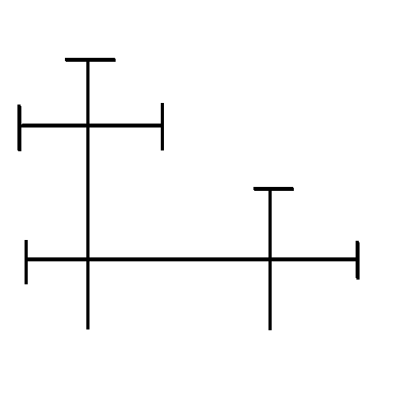
The Maze
3 Simple Rules
Only Straight Lines
Intersections Must Be 4 Way
Dead Ends Must Have T’s

Slide 6
Our Application
Discover Mazes
Uses All Sensors
Each New Intersection Adds A Node On The Stack
Each Dead End Modifies The Value On Top Of The Stack
3 Dead Ends Pops A Node Off The Stack
Solve Mazes
Uses The Previously Generated Stack
Uses Time Based Turns
Each Intersection Pops One Node off the Stack

Slide 7
The User Interface
Send List Items To The Android Phone
Message Handler To Receive User Input
Main Menu
Discover
Solve

Slide 8
The Stack
Simple Linked List Than Holds Integers
0 = Left
1 = Straight
2 = Right
Can Modify The Top Value

Slide 9
State Machines
3 State Machines
UI State Machine
Discover State Machine
Solve State Machine
Switch Cases

Slide 10
Timers
The Raspberry Pi Does Not Have An Internal Clock
We Are Timing CPU Cycles Given To Us By The Operating System

Slide 11
GPIO
All Digital Pins
Sensors Are Either Black Or White
Motors Are On Or Off

Slide 12
How We Could Have Improved
5V Motors With A 5V Regulator
Better Optical Sensors
More Optical Senors
Rotation Sensor
Accelerometer
Camera?

Slide 13
What We Learned
Robotics Is Hard
Hardware Limits Software
Modern IDEs Are Much Better Than Makefiles
You Have To Pay Attention When You’re On The Linux Command Line

